Slide 1
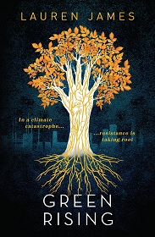
Gabrielle is a climate-change activist who shoots to fame when she becomes the first teenager to display a supernatural ability to grow plants from her skin. Hester is the millionaire daughter of an oil tycoon and the face of the family business. Theo comes from a long line of fishermen, but his parents are struggling to make ends meet.
When Hester and Theo join Gabrielle and legions of other teenagers around the world in developing the strange new "Greenfingers" power, it becomes clear that to use their ability for good, they'll need to learn to work together. But in a time of widespread corruption and greed, there are plenty of profit-hungry organizations who want to use the Greenfingers for their own ends. And not everyone would like to see the Earth saved...
A Young Adult climate change thriller about nature, geoengineering and civil disobedience in the face of overwhelming corporate negligence.
Finalist of the Hollywood Climate Summit 2022 Writing Climate Pitchfest for Film and TV
“A terrifically bold and original take on climate fiction” – The Bookseller
“A smart, brilliantly realised call to arms.” – The Guardian

Slide 2
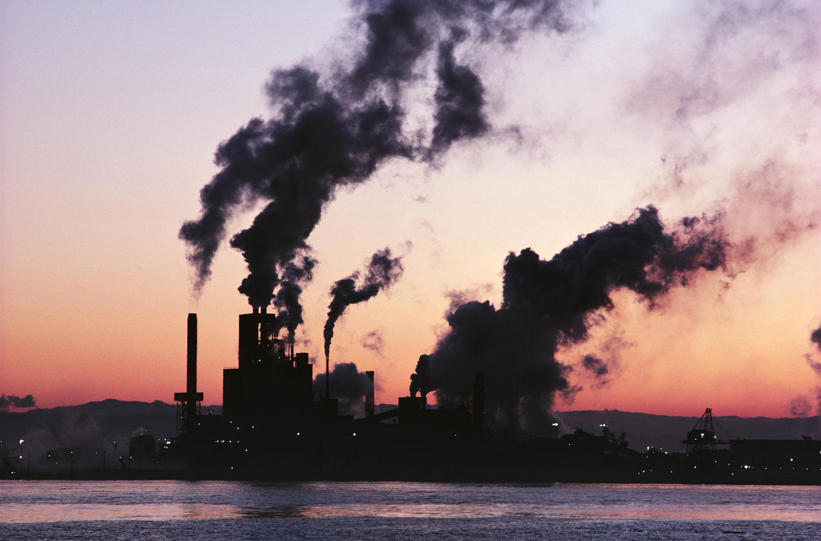
“I fully believe that if humanity continues on its current path, we will be extinct within several hundred years. Our current society isn’t sustainable, in a way that’s not going to be solved by using less plastic on an individual level”.
(Lauren James)
https://www.ciwem.org/news/interview-climate-fiction-writers-league-founder-lauren-james
https://climate-fiction.org/

Slide 3
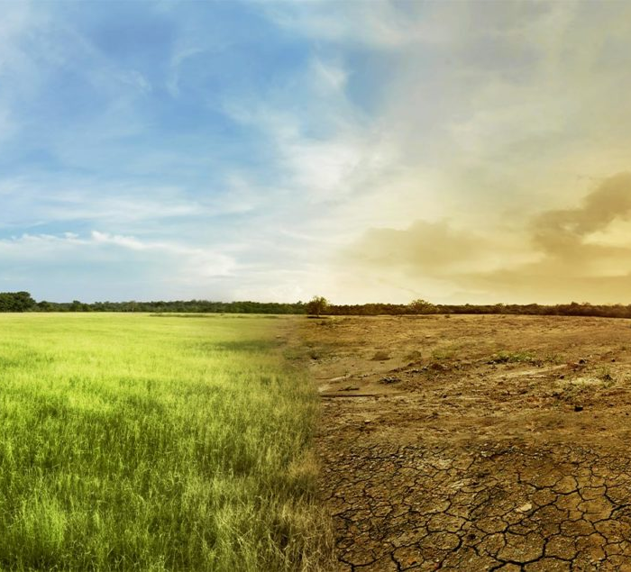
“The climate emergency is the defining human rights issue for this generation of children.
Its consequences will shape their lives in almost every way imaginable. The failure of most governments to act in the face of overwhelming scientific evidence is arguably the biggest
inter-generational human rights violation in history”.
Amnesty International’s Secretary General
Kumi Naidoo.
Climate change could influence crop yields by 2030 - PetOperator.com

Slide 4
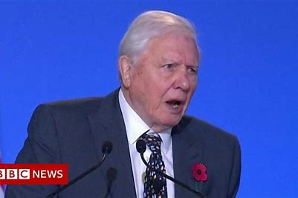
“We are already in trouble. The stability we depend on is breaking.
(…) Ultimately all of us will feel the impact, some of which are now unavoidable.
Is this how our story is going to end?
A tale of the smartest species doomed by that all too human characteristic of failing to see the bigger picture in pursuit of short-term goals.
Perhaps the fact that the people most affected by climate change are no longer some imagined future generations but young people alive today, perhaps that will give us the impetus we need to rewrite our story, to turn this tragedy into a triumph. We are after all the greatest problem solvers to have existed on earth”.
David Attenborough, extract of COP26 address
to delegates
COP26: 'Not fear, but hope' - Attenborough speech in full - Bing video

Slide 5
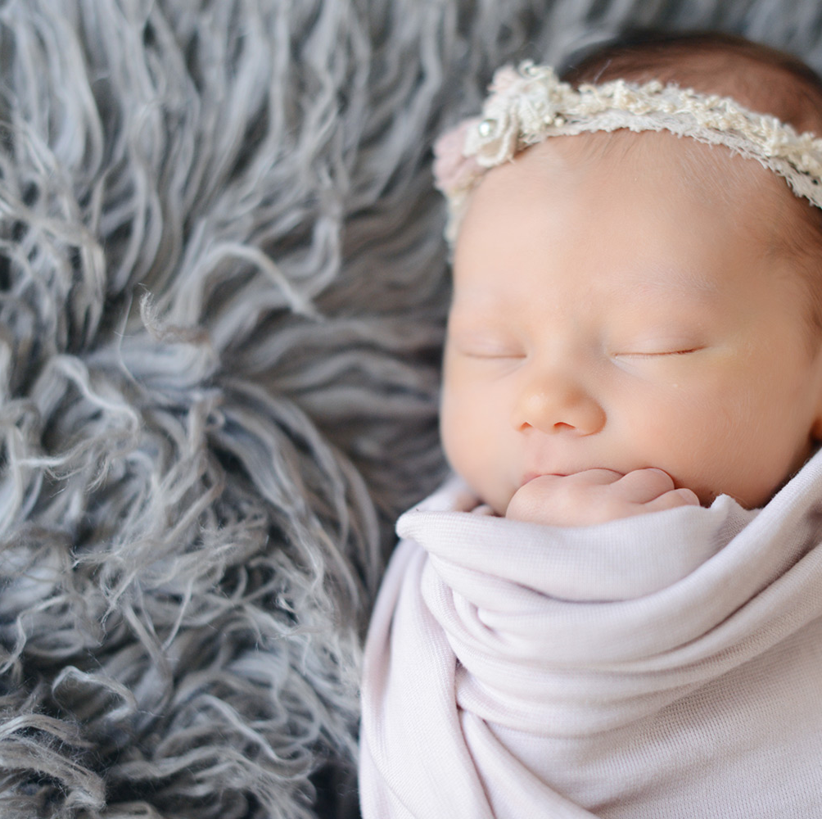
What is a baby born in 2020 likely to witness by the time they reach the age of 80 if humans do not radically change the way they interact with nature?
What does the future look like: future consequences of climate change on flora/ fauna/ humans depending on how many degrees it warms up?
From 15:50mins to 20:24
Our planet, our business (WWF)
https://www.youtube.com/watch?v=JdWQJq2OkJs (38 mins)
Answer: from 18:36mins
See what three degrees of global warming looks like | The Economist - YouTube

Slide 6
Give examples of CURRENT obvious climate change affecting wildlife/ affecting humans/ affecting our weather/ affecting the oceans/ affecting land
WWF website https://www.wwf.org.uk/learn/effects-of/climate-change,
Nasa website https://climate.nasa.gov/effects/,
Met Office https://www.metoffice.gov.uk/weather/climate-change/effects-of-climate-change
David Attenborough, A Life on Our Planet
Either on Netflix (if you have it at home) or using this link: https://www.youtube.com/watch?v=9ta3nbOfJS8 (1h23)

Slide 7
Resources on ‘Green Rising’
Interview about Green Rising: https://laurenejames.co.uk/2021/10/11/plant-magic-the-climate/
https://laurenejames.co.uk/green-rising/
https://laurenejames.files.wordpress.com/2021/10/green-rising-book-club-notes.pdf
Scheme of Work (guidance for teachers) [Word Document download]
https://climatefictionwritersleague.files.wordpress.com/2022/07/year-7-green-rising-booklet.pdf
Produced by Mr B Tillbrook, librarian at Invicta Grammar School (suitable from Year 7) Green Rising
This guided Reading booklet includes: about the author, things to think about when reading, extract from the novel, challenge activity, extension tasks, letter from the author, further reading.
Useful discussion guide: https://laurenejames.co.uk/2021/10/18/discussion-guide-for-green-rising/
https://climatefictionwritersleague.substack.com/p/positivity-in-the-apocalypse-can
Fun Quiz: https://uquiz.com/quiz/KIuEXC/what-plant-are-you

Slide 8
Questions to pupils- things to discuss
How do you feel about climate change?
What do you already do at your level?
What else do you think you could do?
Climate change in the book: how is it depicted?
What is humanity doing in the book to mitigate climate change disasters?
Give me examples of geoengineering ideas with their potential good/harmful consequences.
Gabrielle, the “Greta Thunberg” inspired character:
Who is she? What does she want to do and how close to reality is she in the book?
Edgar Warren, the “Elon Musk” inspired character:
Who is he? What does he want to do? How close to reality is the fictional character?
Climate Rebellion as Extinction Rebellion. Who are they? What do they want to do? How close to reality is the fictional environmental activist group?

Slide 9
Truly inspiring ideas to tackle climate change
or mitigate its consequences:
https://time.com/5389782/boyan-slat-plastic-ocean-cleanup/ (1min39)
https://www.linkedin.com/company/biohm (3mins05)
https://foodsteps.earth/how-it-works/
https://www.biootech.com/ (energy from soil, show first few mins)
9 things you can do about climate change (imperial.ac.uk)
Climate change activism (websites):
Fridays For Future is an international climate movement active in most countries and our website offers information on who we are and what you can do.
Greenpeace UK
Friends of the Earth | Home
Humanity: under threat from climate change | Amnesty International UK

Slide 10
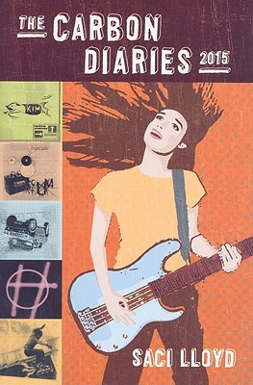
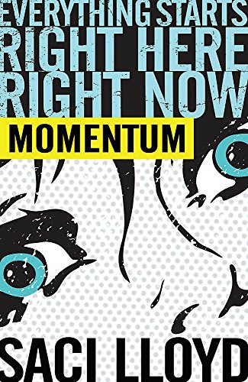
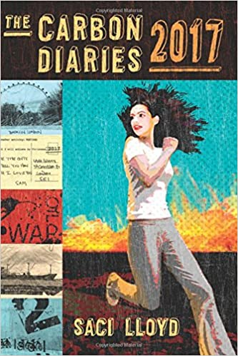
Further readings: FICTION
London, the near future. Energy wars are flaring across the globe - oil prices have gone crazy, regular power cuts are a daily occurrence. The cruel Kossak soldiers prowl the streets, keeping the Outsiders - the poor, the disenfranchised - in check. Hunter is a Citizen: one of the privileged of society, but with his passion for free running and his rebel friend Leo he cannot help but be fascinated by the Outsiders. So when he meets Outsider Uma, he is quickly drawn into their world - and into an electrifying and dangerous race to protect everything they hold dear.
The books follow 16-year-old Londoner Laura Brown, along with her family, neighbours and bandmates through the first year of carbon rationing in the UK.
As the nation adjusts to a radically altered set of environmental targets, the impacts of climate change, both socially and environmentally, begin to make themselves known.
In the second book, Laura is at university in a much-changed London and her band the angels set off on tour across a Europe awash with climate migrants, water wars and neo-Nazis.
Books that Informed Our Politics: The Carbon Diaries - The Social Review

Slide 11
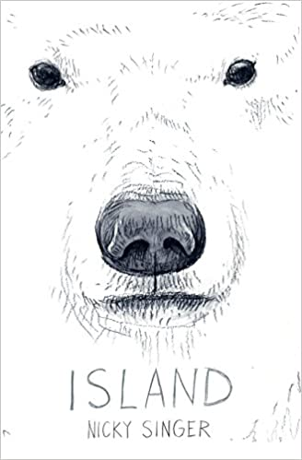

Further readings: FICTION
Urban teenager Cameron arrives on an uninhabited Arctic Island. He's prepared for ice and storms and, stripped of his smart technology, possibly boredom. But he's not prepared for 24-hour daylight and erupting graves! At first Cameron believes the explanations of his research scientist mother. But, as the island reveals itself to him, he begins to see, and hear, things that push him right to the edge of the possible.
In a world full of checkpoints and controls, can love and hope defy the borders? A searing, timely story, as arresting as it is beautiful.
Imagine a world ...
Where there are too many people on a too-hot earth and your only chance of salvation is to journey north.
Where you must prove yourself worthy of existence at every turn, at every checkpoint.
Where your instincts become your most powerful weapon - even more than the gun in your pocket.
Where you find out what it takes to survive.

Slide 12


Further readings: FICTION
First came the storms.
Then came the Fever.
And the Wall.
After a string of devastating hurricanes and a severe outbreak of Delta Fever, the Gulf Coast has been quarantined. Years later, residents of the Outer States are under the assumption that life in the Delta is all but extinct… but in reality, a new primitive society has been born.
Blue skies. Green grass. Clear ocean water. An island paradise like the ones that existed before “the Melt”.
A lucky five hundred lottery winners will be the first to go, the first to leave their polluted, dilapidated homes behind. It sounds perfect.
The only problem? Marin Carey spent her childhood on those seas and knows there's no island paradise out there. She knows a con when she sees one. So where are the First Five Hundred really going?
A bleak, futuristic world that's utterly believable and terrifying, and yet from out of it springs the greatest of hope, carried on the back of its fierce main characters.

Slide 13
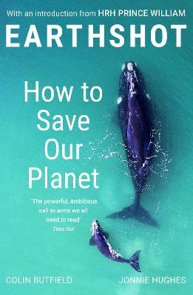
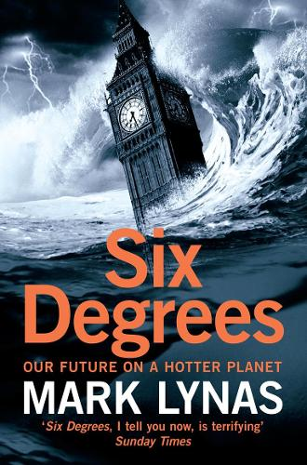
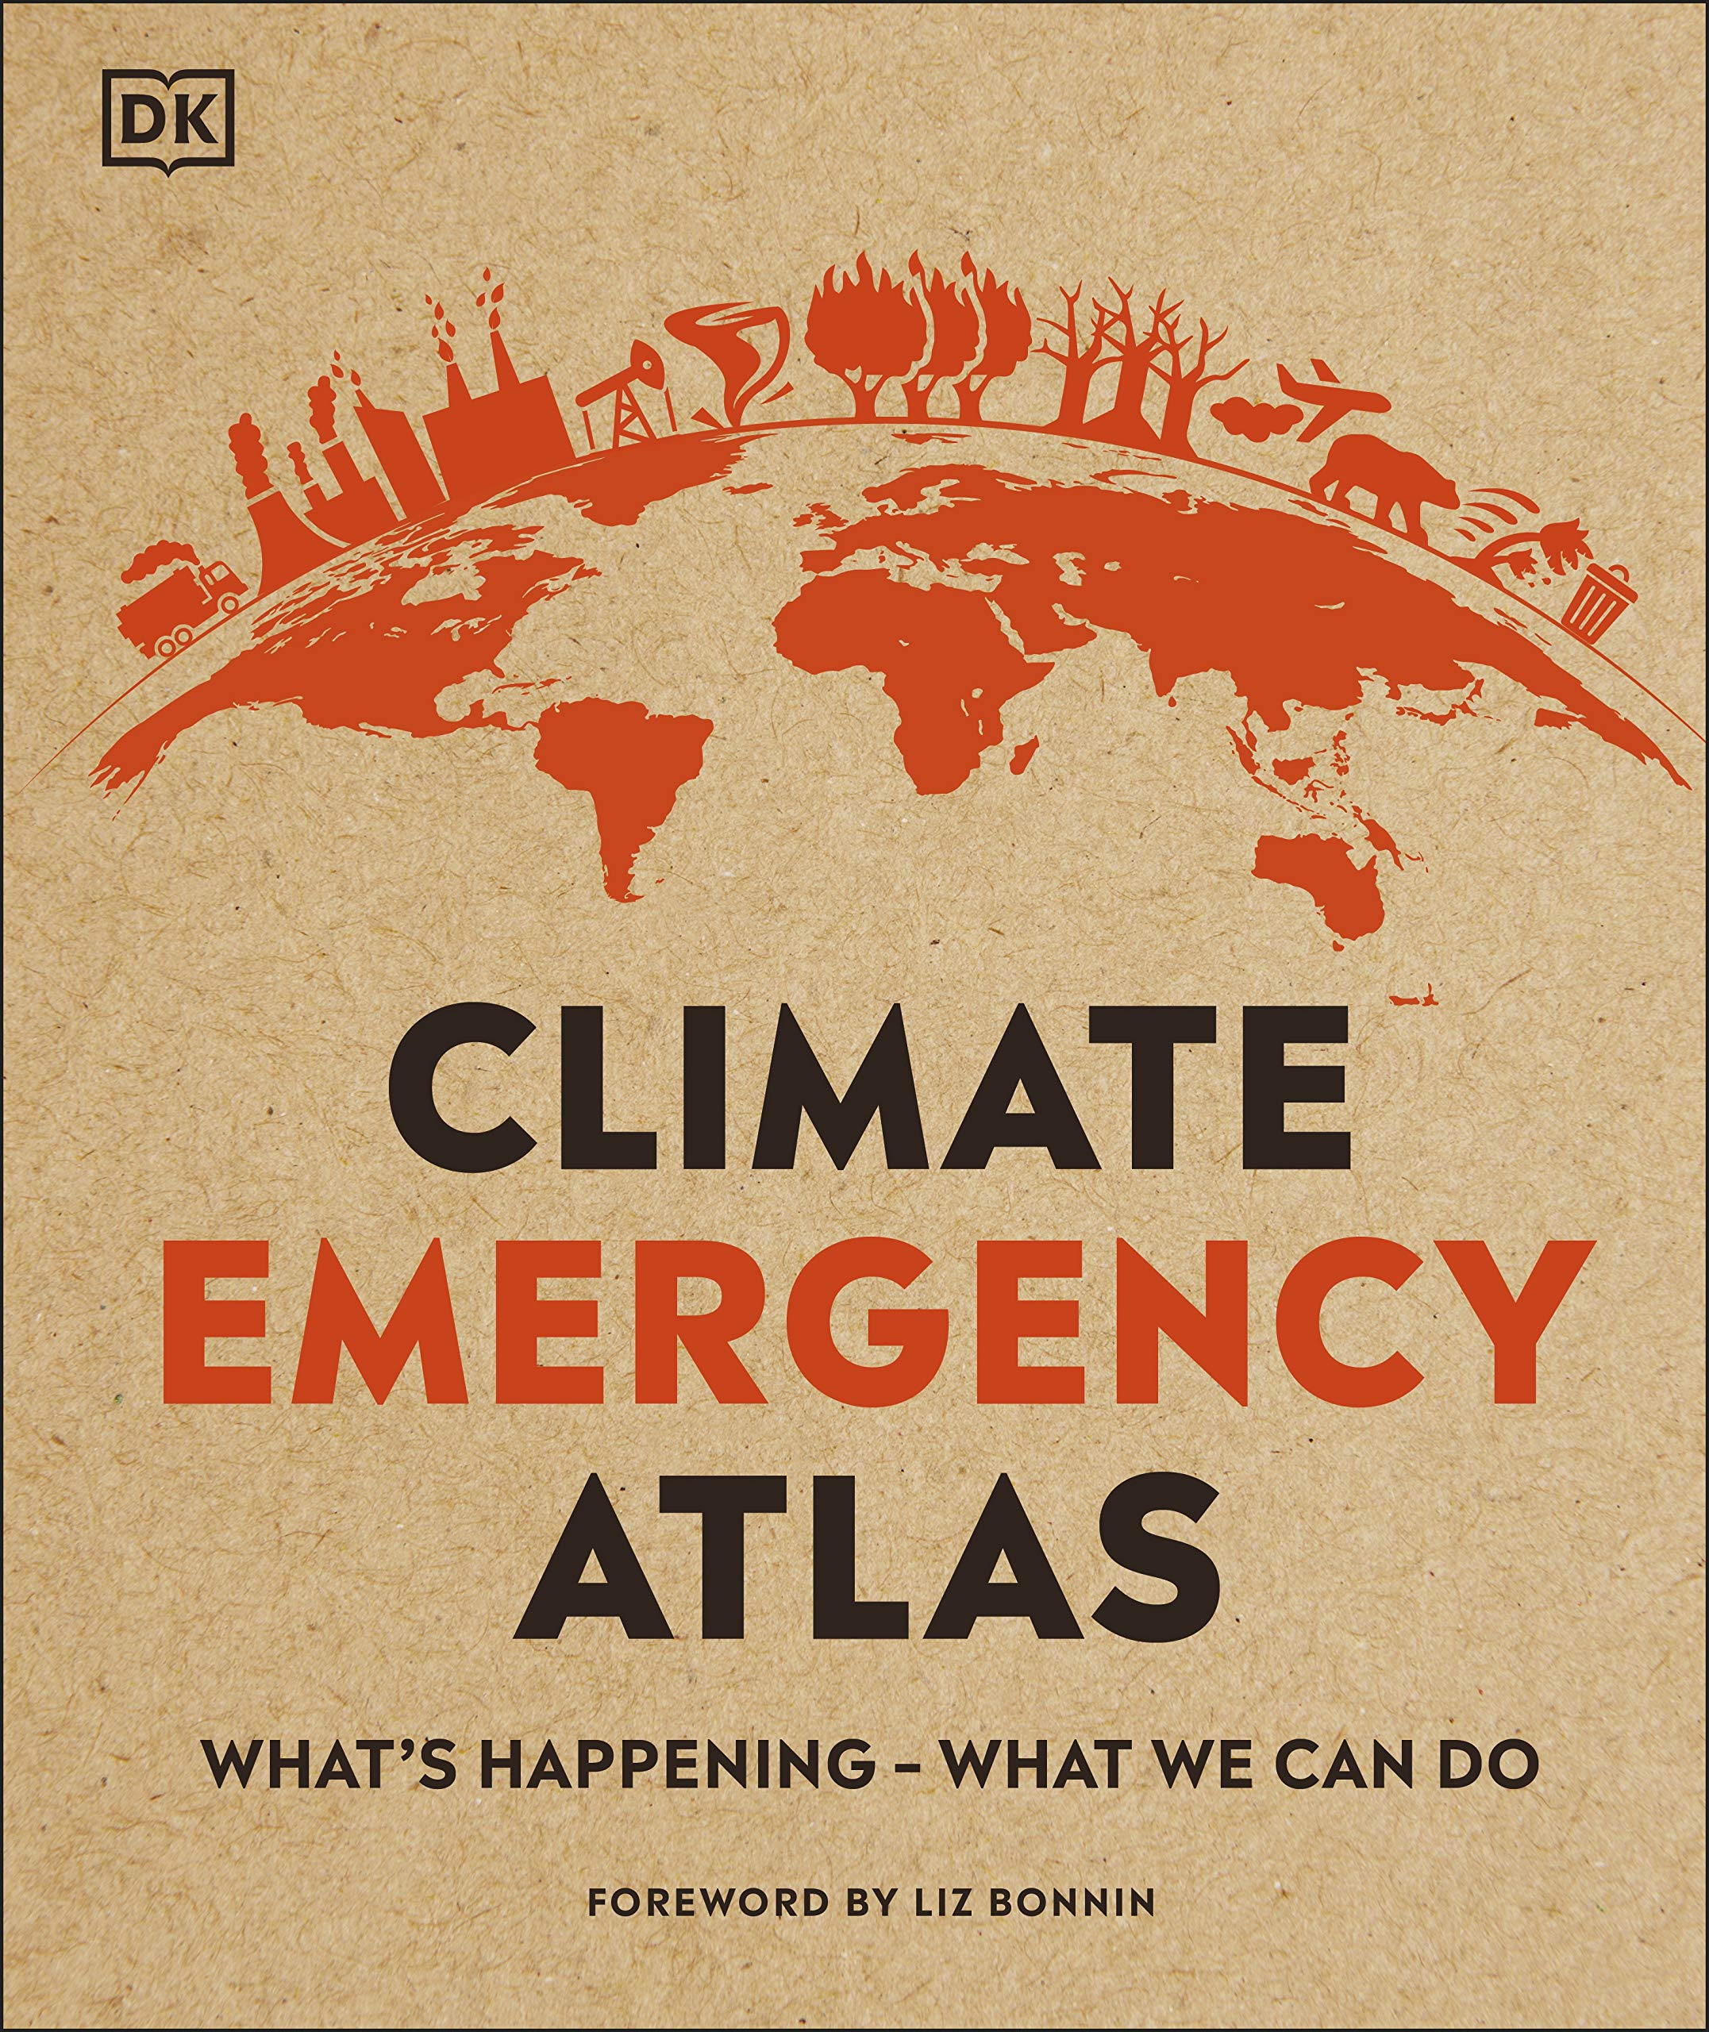
Further readings: NON-FICTION

Slide 14
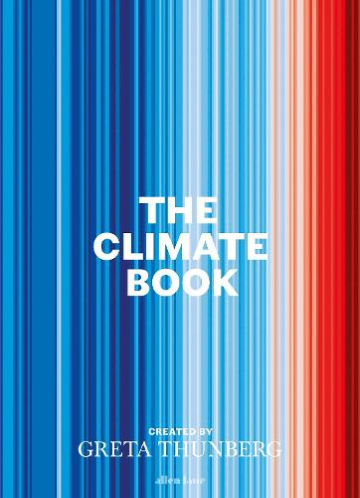
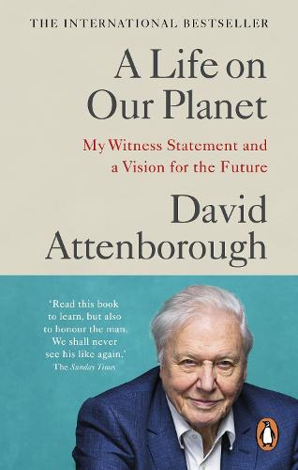
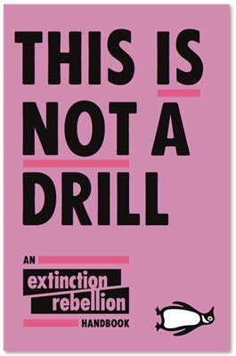
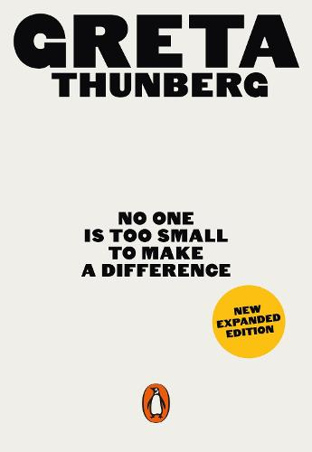

Slide 15
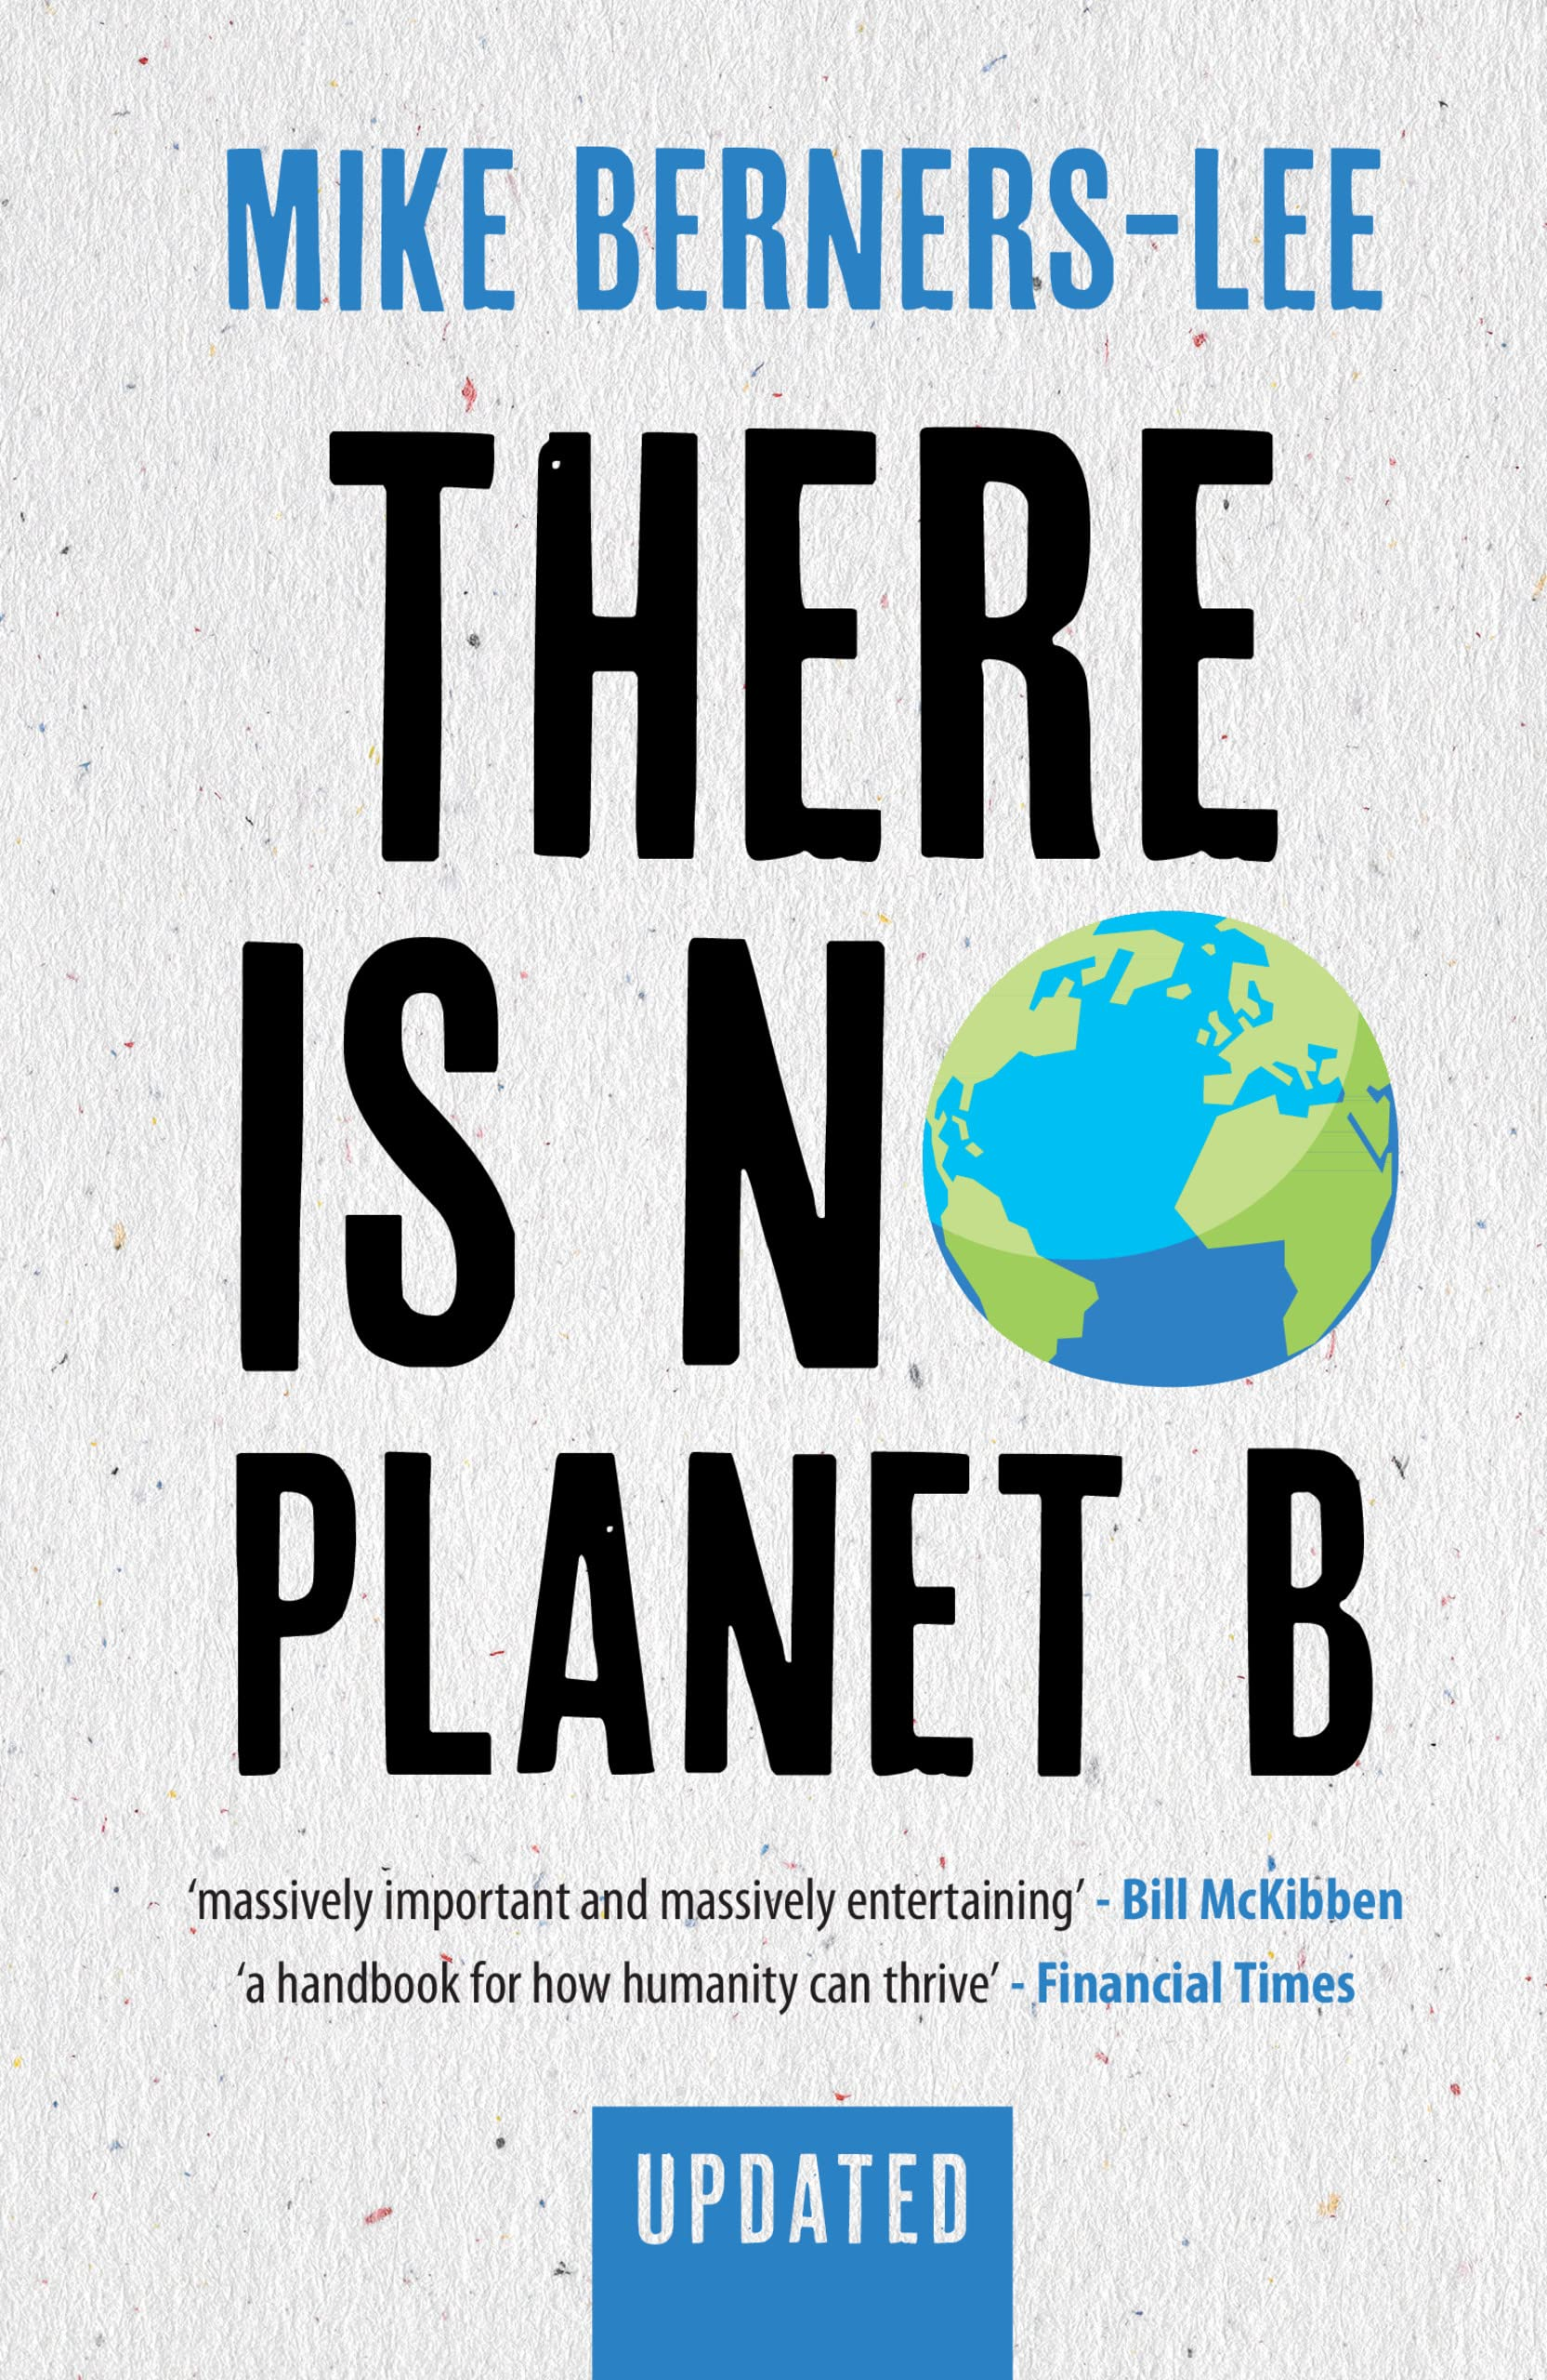
Feeding the world, climate change, biodiversity, antibiotics, plastics, pandemics - the list of concerns seems endless.
But what is most pressing, and what should we do first? Do we all need to become vegetarian? How can we fly in a low-carbon world? How can we take control of technology? And, given the global nature of the challenges we now face, what on Earth can any of us do, as individuals?
Mike Berners-Lee has crunched the numbers and plotted a course of action that is full of hope, practical, and enjoyable. This is the big-picture perspective on the environmental and economic challenges of our day, laid out in one place, and traced through to the underlying roots - questions of how we live and think. This updated edition has new material on protests, pandemics, wildfires, investments, carbon targets and of course, on the key question: given all this, what can I do?

Slide 16
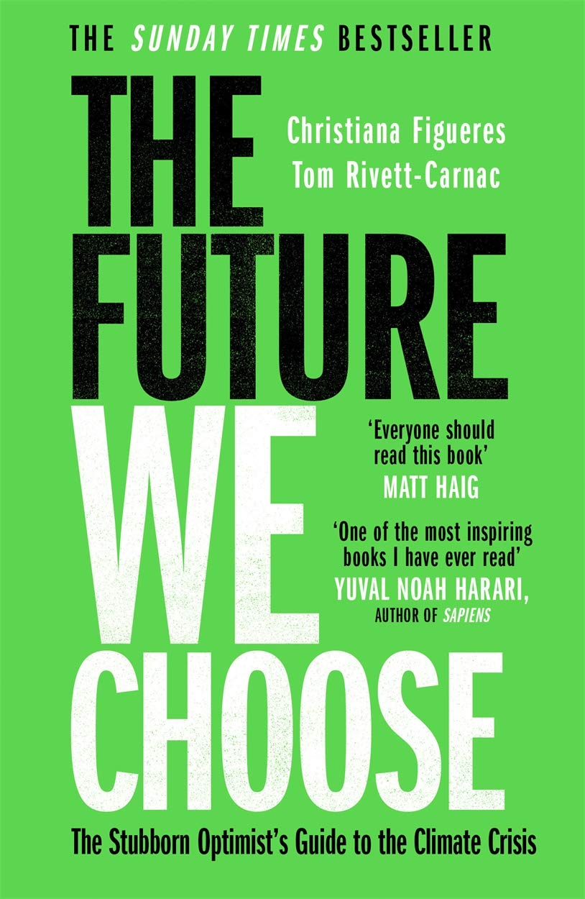
The future is ours to create: it will be shaped by who we choose to be in the coming years. The coming decade is a turning point - it is time to turn from indifference or despair and towards a stubborn, determined optimism.
The Future We Choose is a passionate call to arms from former UN Executive Secretary for Climate Change, Christiana Figueres, and Tom Rivett-Carnac, senior political strategist for the Paris Agreement.
Practical, optimistic and empowering, The Future We Choose shows us steps we can all take to renew our planet and create a better world beyond the climate crisis: today, tomorrow, this year and in the coming decade.

Slide 17
Teaching resources created by Cecile Semple at Ardingly College (Cecile.Semple@ardingly.com)

