Slide 1
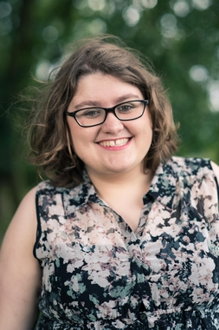
Lauren James is the twice Carnegie-nominated author of
The Quiet at the End of the World, The Loneliest Girl in the Universe, The Reckless Afterlife of Harriet Stoker and The Next Together series.
She sold the rights to her first novel when she was twenty-one.
Lauren teaches creative writing and has written articles for numerous publications, including the Guardian and the Children’s Writers and Artist’s Yearbook.
Her books have sold over fifty thousand copies in the UK and been translated into five languages worldwide.
Lauren is a passionate advocate of STEM further education, and all of her books feature female scientists in prominent roles.
Lauren runs the Climate Fiction Writers League, which aims at raising awareness of climate change and encouraging positive action.
https://climate-fiction.org/
Twitter at @Lauren_E_James http://www.laurenejames.co.uk
https://www.walker.co.uk/contributors/Lauren-James-14601.aspx

Slide 2

What was your favourite book when you were a child?
I loved Artemis Fowl, Narnia, His Dark Materials and the Old Kingdom trilogy. Anything with sassy sidekicks, talking animals and a hint of magic had me hooked. And of course, Harry Potter – but I think that is a given!
What’s the best thing about writing for young adults?
I love being able to take a high concept scenario – like being one of the last people to ever exist – and making that relatable for teenagers today. What do you do with your time, knowing that every second of your life is the culmination of the entire history of your ancestors? What kind of person should you be? How can you be an individual without looking ahead or behind you? Should you even try?
Those questions are especially relevant to YA fiction – every teenager is wondering who they are, what kind of person they want to grow up to be, and how they can make a difference to the world.
The best science fiction uses imaginary scenarios to highlight the issues we face today. Giving teenagers an escape from real life, while also providing some element of comfort and relatability, is the best part of writing YA.
https://laurenejames.co.uk/interview-answers/

Slide 3

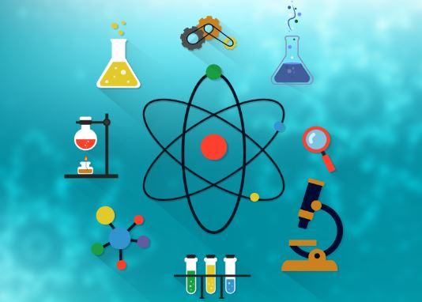
What would you be if not an author?
I studied Chemistry and Physics at university, so if I hadn’t become a writer, I would probably be a research scientist focusing on physical chemistry.

Slide 4
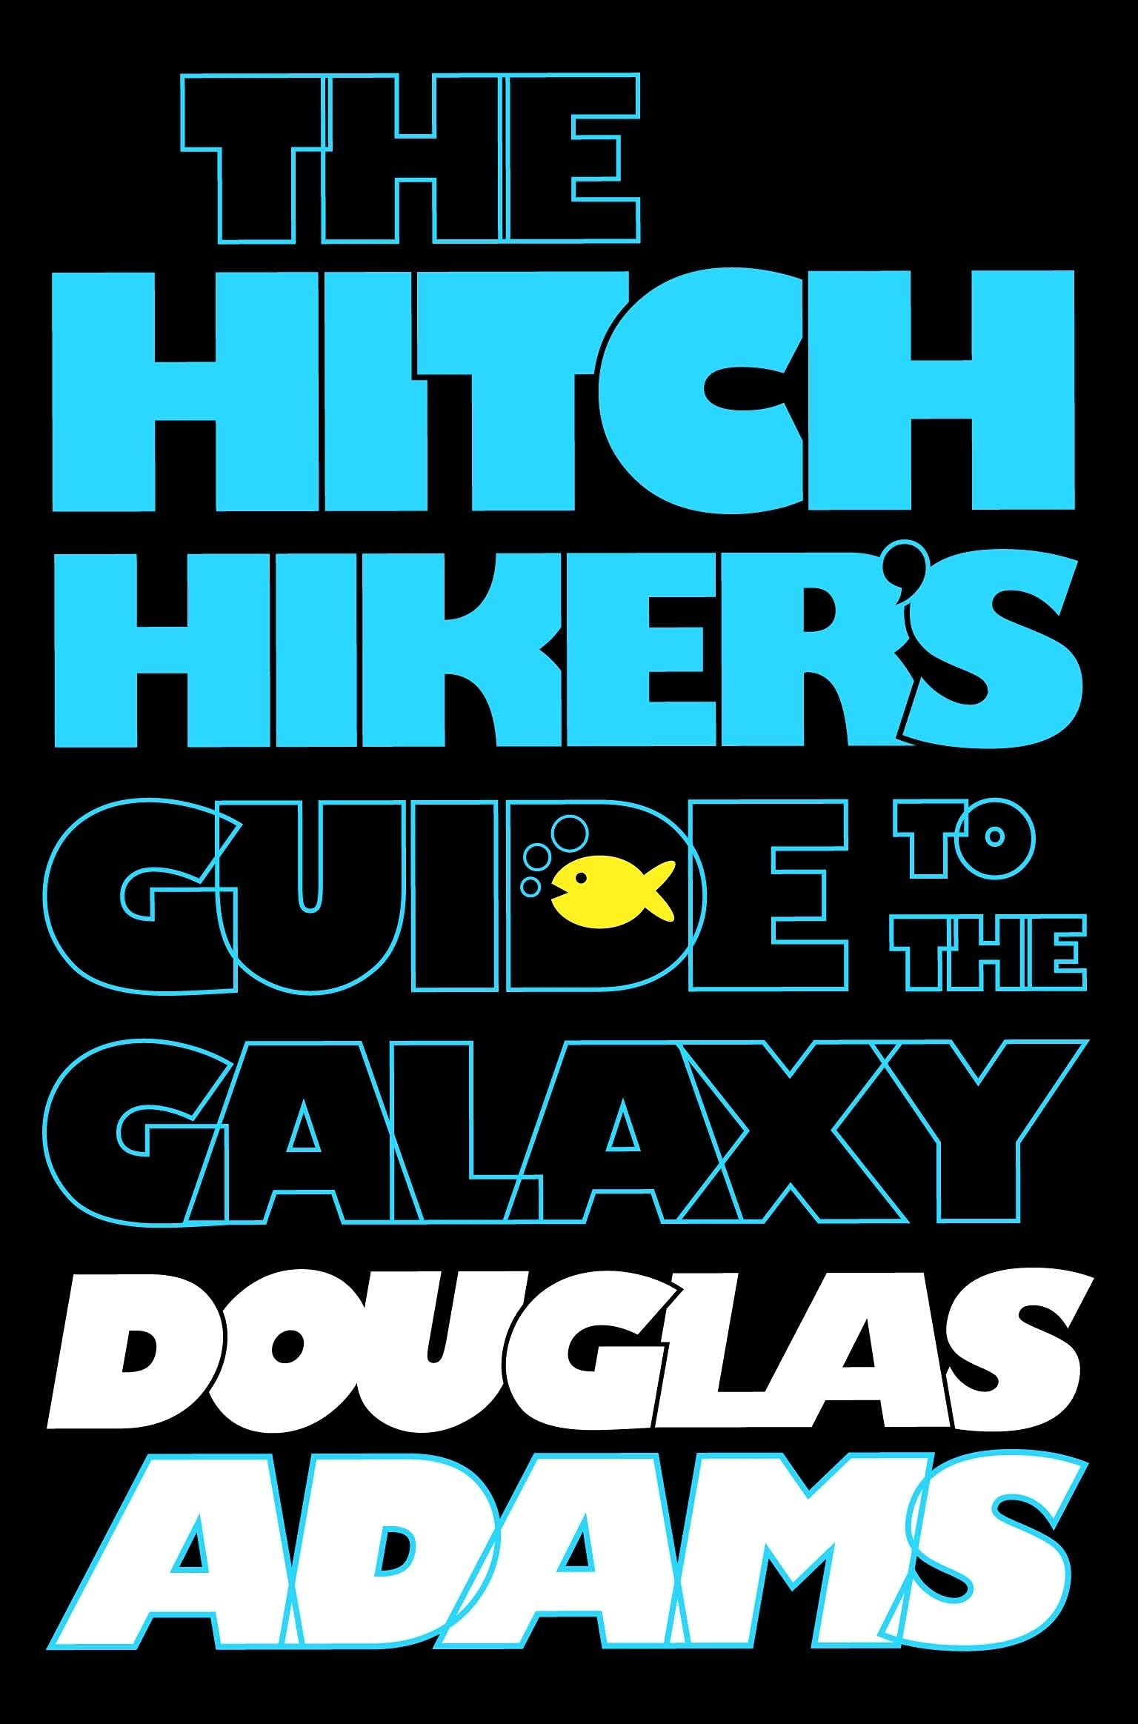
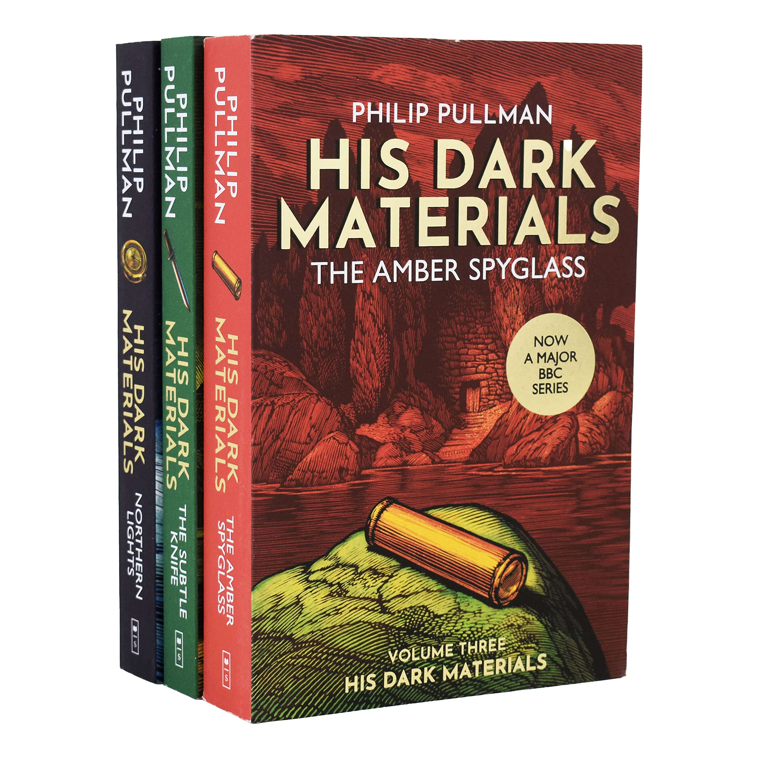
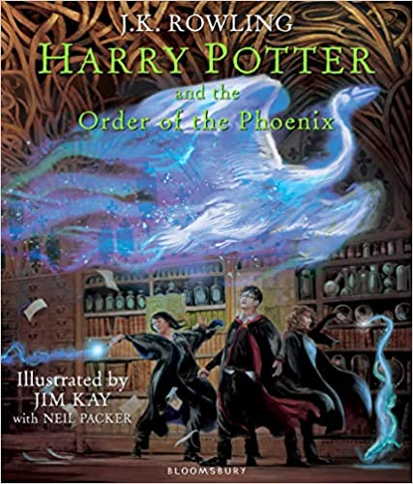
Name three authors that were influential to your work and tell us why
Douglas Adams – ‘The Hitchhikers’ Guide to the Galaxy’, funny sci fi
Philip Pullman – scientific explanations in high concept plots, ‘His Dark Materials’ blew my mind – I couldn’t believe that the fantasy world with talking bears and daemons was actually based on dark matter and science. That was just a complete change of perspective for me, about what writing could and should be.
JK Rowling – anyone can write a book!
https://laurenejames.co.uk/interview-answers/

Slide 5
“Personally, I am attracted to YA because it gives me things that simply aren’t available in Adult fiction. I joke that as a teenager I read adult fiction, and as an adult I read teenager fiction. That’s completely true, and I’ve spoken to many people with the same experiences.
I want to read diverse, fresh and socially conscious stories which represent the reality of the world I live in. I really wasn’t finding that in the Literary Fiction I was reading. YA is on the cutting edge of fiction, taking risks to do new things which other areas of publishing have never done.
The YA reading community is so passionate and socially aware, and that demand online for better and more respectful diversity has encouraged more publishers to buy diverse books, meaning that YA books are on the forefront of change. ”

Slide 6
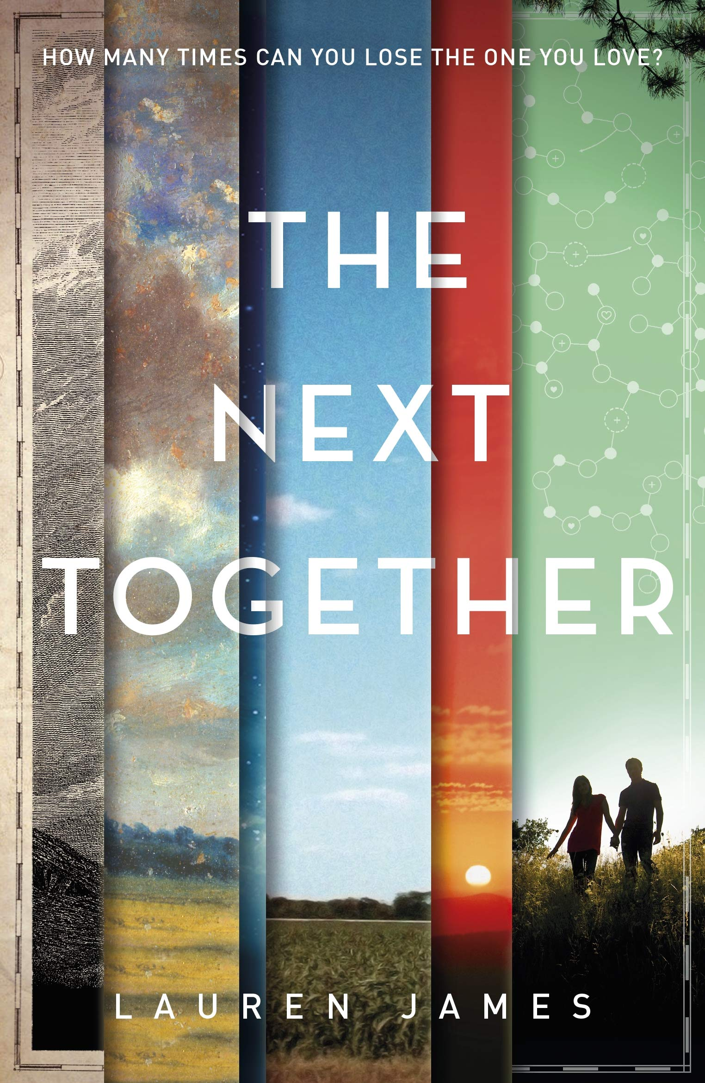
A powerful and epic debut novel about fate and the timelessness of first love.
Katherine and Matthew are destined to be born again and again. Each time their presence changes history for the better, and each time, they fall hopelessly in love, only to be tragically separated.
How many times can you lose the person you love? For Matthew and Katherine it is again and again, over and over, century after century. But why do they keep coming back? How many times must they die to save the world? What else must they achieve before they can be left to live and love in peace?
Maybe the next together will be different…

Slide 7
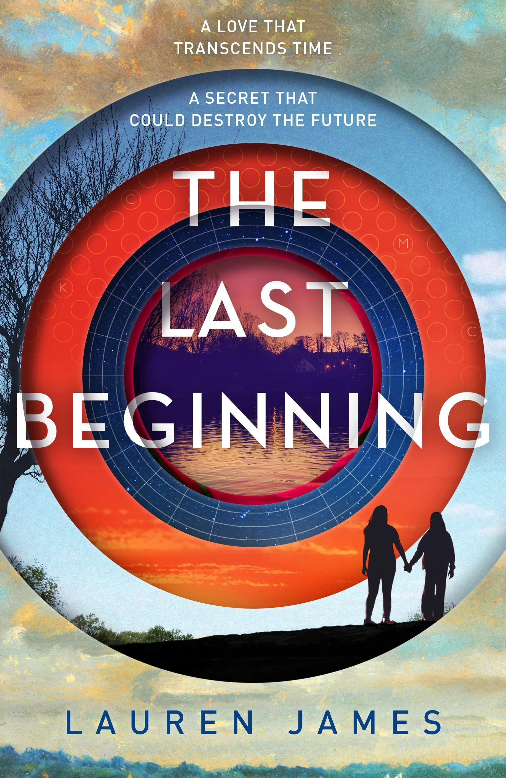
The epic conclusion to Lauren James’ debut The Next Together about true love and reincarnation.
Sixteen years ago, after a scandal that rocked the world, teenagers Katherine and Matthew vanished without a trace.
Now Clove Sutcliffe is determined to find her long lost relatives…
But where do you start looking for a couple who seem to have been reincarnated at every key moment in history? Who were Kate and Matt? Why were they born again and again? And who is the mysterious Ella, who keeps appearing at every turn in Clove's investigation? For Clove, there is a mystery to solve in the past and a love to find in the future.

Slide 8
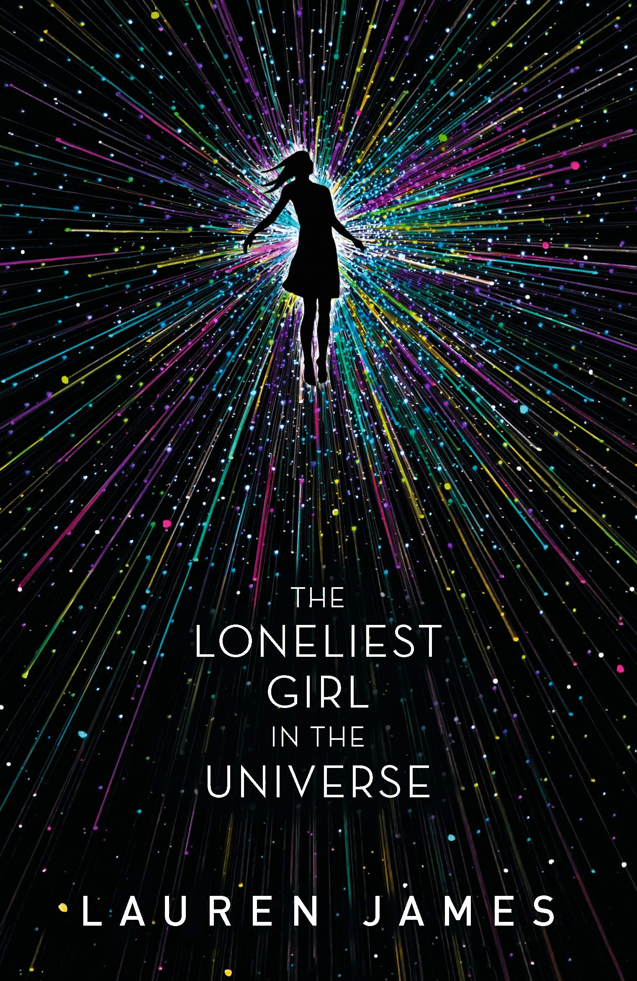
Can you fall in love with someone you've never met, never even spoken to – someone who is light years away?
Romy Silvers is the only surviving crew-member of a spaceship travelling to a new planet, on a mission to establish a second home for humanity.
Alone in space, she is the loneliest girl in the universe until she hears about a new ship which has launched from Earth – with a single passenger on board. A boy called J. Their only communication is via email – and due to the distance between them, their messages take months to transmit. And yet Romy finds herself falling in love, but what does she really know about J?
Nominated for the 2019 Carnegie medal
Shortlisted for the STEAM Children’s Book Prize
“The Loneliest Girl in the Universe is shocking and brutal and has the best twist I've ever read. The sinister realism of Romy's situation is as terrifying as it is gripping, and I was rooting for her from beginning to end.” ― Alice Oseman

Slide 9
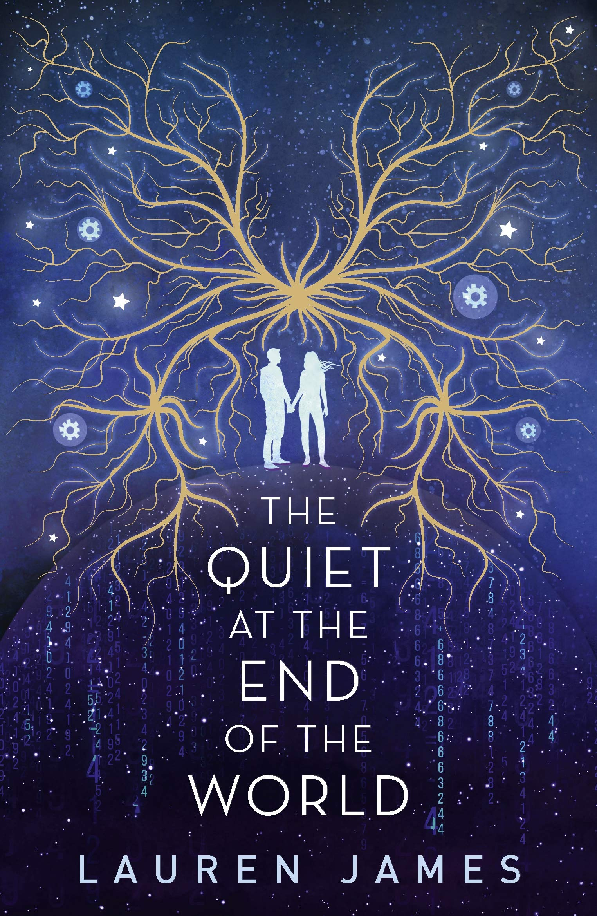
How far would you go to save those you love?
Lowrie and Shen are the youngest people on the planet after a virus caused global infertility.
Closeted in a pocket of London and doted upon by a small, ageing community, the pair spend their days mudlarking and looking for treasure – until a secret is uncovered that threatens not only their family but humanity’s entire existence.
Now Lowrie and Shen face an impossible choice: in the quiet at the end of the world, they must decide what to sacrifice to save the whole human race...
Shortlisted for the YA Book Prize
Winner of the RED Book Award

Slide 10
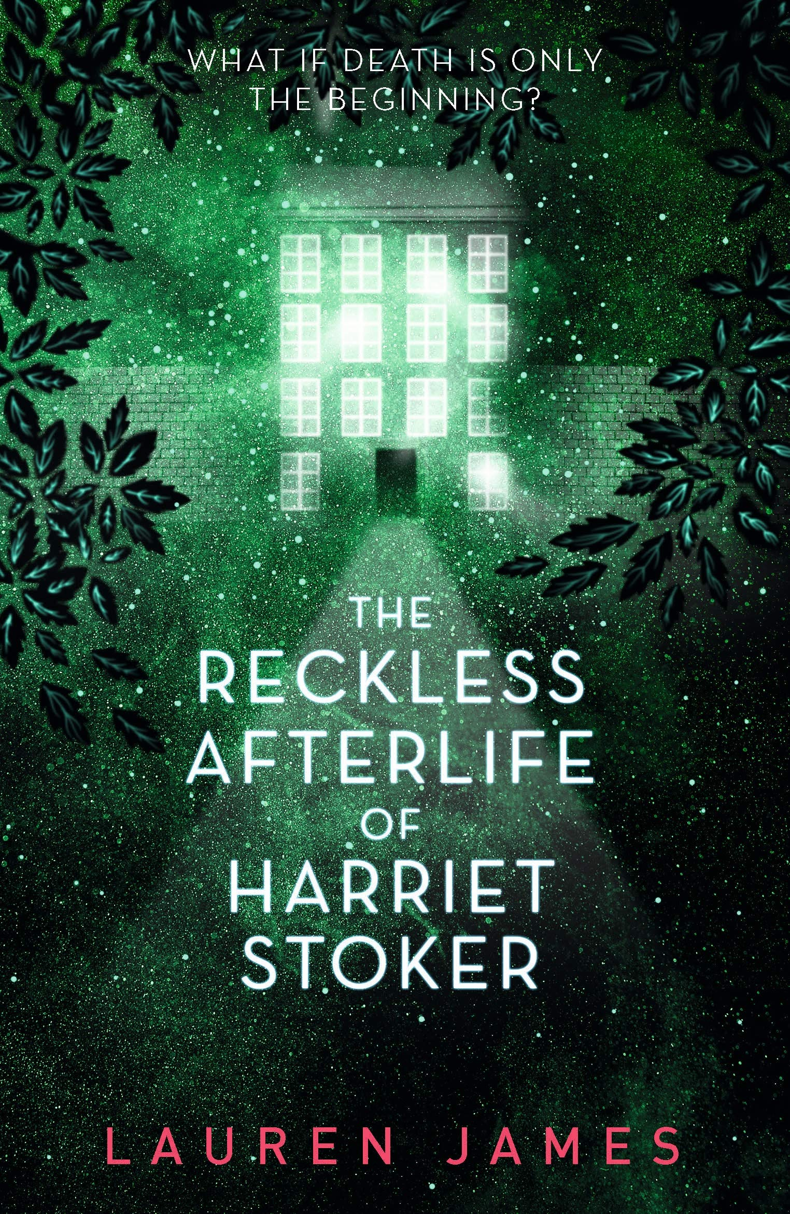
What if death is only the beginning?
When Harriet Stoker dies after falling from a balcony in a long-abandoned building, she discovers a world of ghosts with magical powers – shape-shifting, hypnosis, even the ability to possess the living.
Felix, Kasper, Rima and Leah welcome her into their world, eager to make friends with the new arrival.
Yet Harriet is more interested in unleashing her own power, even if it means destroying everyone around her. But when all of eternity is at stake, the afterlife can be a dangerous place to make an enemy.
Shortlisted for the 2021 CrimeFest Award for Best Crime Novel for Young Adults
Shortlisted for the 2022 Grampian Children’s Book Award
“Lauren James is a genius.” SFX Magazine

Slide 11
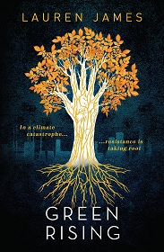
Gabrielle is a climate-change activist who shoots to fame when she becomes the first teenager to display a supernatural ability to grow plants from her skin. Hester is the millionaire daughter of an oil tycoon and the face of the family business. Theo comes from a long line of fishermen, but his parents are struggling to make ends meet.
When Hester and Theo join Gabrielle and legions of other teenagers around the world in developing the strange new "Greenfingers" power, it becomes clear that to use their ability for good, they'll need to learn to work together. But in a time of widespread corruption and greed, there are plenty of profit-hungry organizations who want to use the Greenfingers for their own ends. And not everyone would like to see the Earth saved...
A Young Adult climate change thriller about nature, geoengineering and civil disobedience in the face of overwhelming corporate negligence.
Finalist of the Hollywood Climate Summit 2022 Writing Climate Pitchfest for Film and TV
“A terrifically bold and original take on climate fiction” – The Bookseller
“A smart, brilliantly realised call to arms.” – The Guardian

Slide 12
Teaching resources created by Cecile Semple at Ardingly College (Cecile.Semple@ardingly.com)

